Slide 1
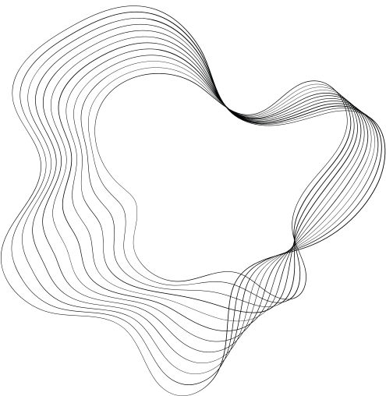


TRACING OF CURVE
y^2(a+x)=x^2(a-x)
mathematics presentation
session 2024-25
by
shreya verma

Slide 2
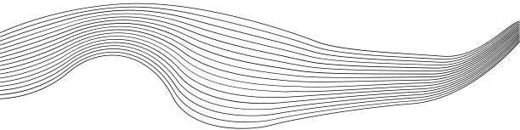

STEPS TO SOLVE TO GET A CURVE OUT OF A EQUATION
01
SYMMETRY
NATURE OF ORIGIN AND TANGENT AT ORIGIN
02
POINT OF INTERSECTION WITH COORDINATES
03
04
ASYMPTOTES
05
SOLVE FORR YAND X
06
REGION OF CURVE
07
SPECIAL POINTS
08
POINT OF INFLEXION

Slide 3




SYMMETRY
The given equation is:
y2(a+x)=x2(a−x)
The presence of y^2 indicates that y appears only as y^2 meaning the curve is symmetric about the x-axis. If (x,y) is on the curve, (x,−y) is also on the curve.

Slide 4




ORIGIN
To determine whether the curve passes through the origin (0,0)(0, 0)(0,0):
Substitute x=0x = 0x=0 and y=0y = 0y=0 into the equation:
y2(a+0)=02(a−0)⟹y2⋅a=0.
Since a≠0 ,y=0 Therefore, the curve passes through the origin.
Near the origin, assume a linear approximation y=mx
Substitute into the equation: (mx)2(a+x)=x2(a−x).
Simplify: m2x2(a+x)=x2(a−x).
Divide through by x2
m2(a+x)=a−x.
At x=0.m2a=a⟹m2=1⟹m=±1.
tangent

Slide 5

POINT OF INTERSECTION
On the x-axis, y=0:
y2(a+x)=x2(a−x) ⟹ 0=x2(a−x).
Factorize:
x2(a−x)=0 ⟹ x=0 or x=a.
On the y-axis, x=0:
y2(a+x)=x2(a−x) ⟹ y2⋅a=0.Since a≠0 y=0 This implies the curve intersects the y-axis at:
(0,0).
ASYMPTOTES
we analyze the behavior as x→∞ and x→−a (where the denominator approaches zero).
the denominator is a+x, which becomes zero when x=−a.
Thus, there is a asymptote at: x=−a
.

Slide 6



REGION OF EXISTANCE
For y2 to be non-negative, the numerator and denominator must have the same sign:
For x>a the numerator is negative and the denominator is positive, leading to a negative y2, which is not allowed.
When x>−a and x<a both the numerator and denominator are positive, so the region of existence is x∈(−a,a)
For x<−a the numerator and denominator are both negative, so y2 remains positive, but this only exists in the region (−∞,−a).
hence the curve exist in the region 0< x< a and -a< x< 0 only.

Slide 7
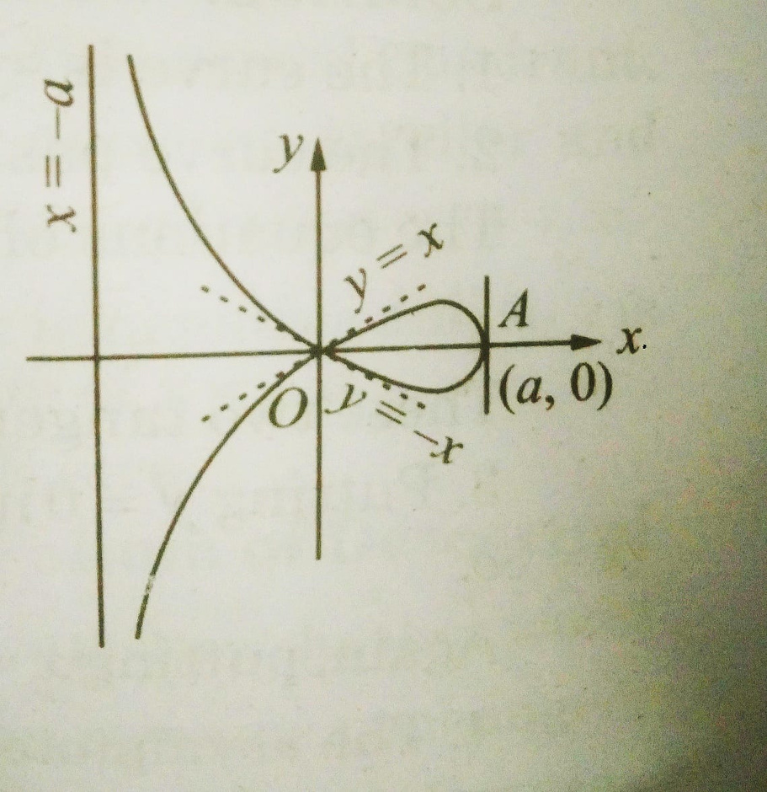
THE CURVE OBTAINED

Slide 8

THANK'S FOR WATCHING

